Slide 1
Feature Extraction Yuchao Dai 2024-04-24
Notes:
In the last two weeks, we mainly focus on low-level computer vision or image processing, where the input is an image and the output is also an image. Now let’s move forward to the next stage, mid-level computer vision, where the input is still an image but the output is not a pure image but a representation of information such as edge, contour, line and etc.

Slide 2
Image Features
Edge feature (contour, boundary, outline, line feature,…)
Point feature ( interest point, corner point, SIFT, ...)
Region feature (patch, super-pixel,… )
Textures ( texton, colour histogram,..)
Notes:
Features can be defined on different levels ranging from point, edge, region to the whole image.
Salient point, how to define it, how to detect it, how to characterize the neighbouring,
The term texton was introduced by Bela Julesz in 1981 to describe "the putative units of pre-attentive human texture perception."^{[1]} The term reemerged in the late 1990s and early 2000s to describe vector quantized responses of a linear filter bank.^{[2][3]}

Slide 3
Edge Detection
Why edges ?

Slide 4

Goal
Input an image, output a set of pixels on curves or line segments that correspond to sharp changes.
Why Edge ? Edge carry important information for visual understanding.
Notes:
Produce a line “drawing” of a scene from an image of that scene.

Slide 5
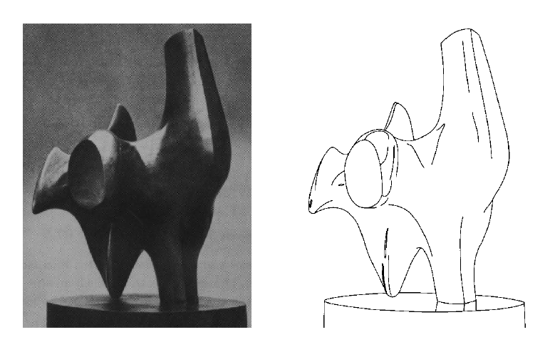
Edge detection
Convert a 2D image into a set of curves
Extracts salient features of the scene
More compact than pixels
Produce a line “drawing” of a scene from an image of that scene.
Notes:
salient, first eye points

Slide 6
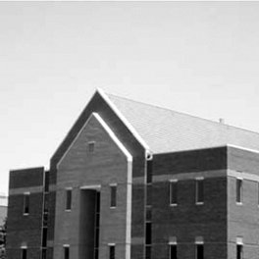
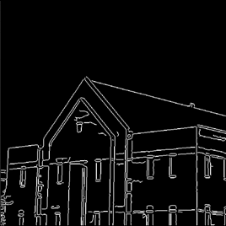
Why Edge ?
Courtesy [Gonzalez & Woods]

Slide 7
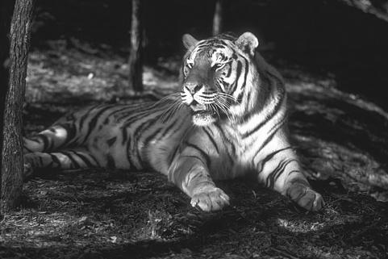
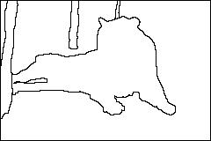
Why Edge?
Reduce dimensionality of data
Preserve content information
Useful in applications such as:
object detection
structure from motion
tracking
Notes:
In the ideal case, the result of applying an edge detector to an image may lead to a set of connected curves that indicate the boundaries of objects, the boundaries of surface markings as well as curves that correspond to discontinuities in surface orientation.
Thus, applying an edge detection algorithm to an image may significantly reduce the amount of data to be processed and may therefore filter out information that may be regarded as less relevant, while preserving the important structural properties of an image. If the edge detection step is successful, the subsequent task of interpreting the information contents in the original image may therefore be substantially simplified.
However, it is not always possible to obtain such ideal edges from real life images of moderate complexity.

Slide 8
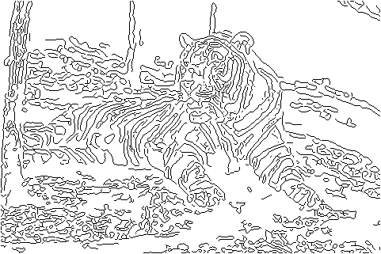
Why not Edge?
But, not that useful, why?
Difficulties:
Modeling assumptions
Parameters
Multiple sources of information (brightness, color, texture, …)
Real world conditions
Is edge detection even well defined?

Slide 9
Definition
An edge is a place where there is a rapid change in the brightness (or other property) of an image.
Notes:
Then the key problem is what is an edge or the definition of edge: A rapid change in the brightness or other property

Slide 10
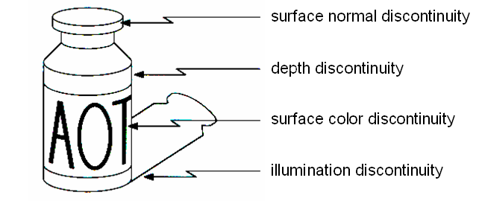
Cause of edges
Depth discontinuity
Surface orientation discontinuity
Reflectance discontinuity (i.e., change in surface material, color properties)
Illumination discontinuity (e.g., shadow)
Notes:
which the image brightness changes sharply or, more formally, has discontinuities
Where does edge come from? There are different causes for edge: 1) depth discontinuity, where the depth of the scene changes a lot 2) Surface normal discontinuity 3) color material 4) illumination discontinuity. So there are many reasons to generate the same response: the edge, it is not easy to distinguish them. For example, in image segmentation, we may more concern about the depth discontinuity to achieve good segmentation

Slide 11
Edge and derivative (or gradient)
Notes:
Generally, although other cues can be used in edge detection, edge is mainly defined upon the change of image intensity. In a zoomed-in window of image patch, let’s show the image response along a horizontal line, we can observe that there are two sudden changes in intensity, if we evaluate the first derivative , two peaks corresponds to the

Slide 12
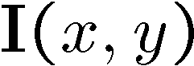
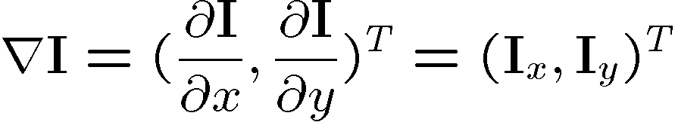
Image Gradient
Think of image intensities as a function . Gradient of image is a vector field as for a normal 2-D height function:
Edge: Place where gradient magnitude is high; orthogonal to gradient direction
Notes:
Think of image intensities as a function I(x,y), a height map, we can define the gradient of image as a vector field (with respect to x,y directions) derivate along
Once we have computed image gradient, we can define edge based on the magnitude of the image gradient, big change of image intensity corresponds to big high magnitude of gradient. The direction is orthogonal to gradient direction

Slide 13
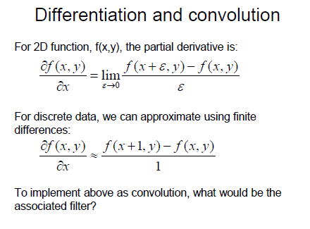
Notes:
How can we compute the image gradient? For continuous function, the partial derivative is defined as the limit of differentiation
For discrete, we approximate using finite differences, as this is defined as pixel-wise computation, we have to resort to convolution to speed up the implementation.
Forward backward or mid-differentiation

Slide 14
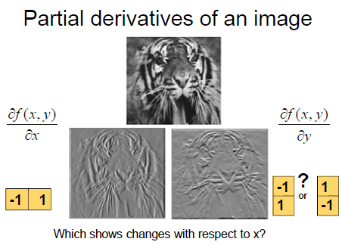

Slide 15

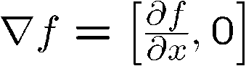
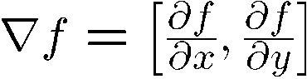
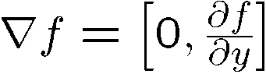
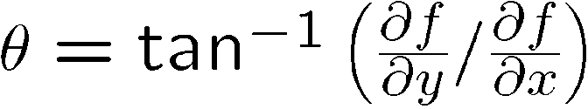
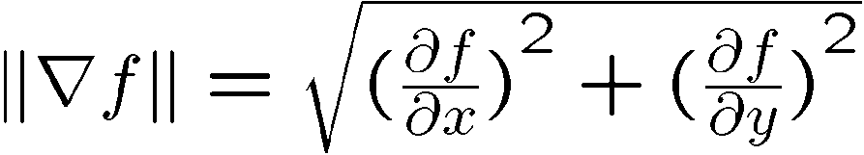
Magnitude and Orientation of an edge
The gradient of an image:
The gradient points in the direction of most rapid change in intensity
The gradient direction is given by:
how does this relate to the direction of the edge?
The edge strength is given by the gradient magnitude

Slide 16
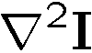
Methods
Using first order derivative: Look for extrema
Sobel operator : edge(I, ‘sobel’);
Prewitt, Roberts,…
Derivative of Gaussian
Using second order derivative: Look for zero-crossings
Laplacian : isotropic
Second directional derivative
LOG/DOG (Laplace of Gaussian/Difference of Gaussians)

Slide 17
Common edge detectors
Basic gradient edge detectors
Sobel, Prewitt, Gaussian derivative …
LoG/Marr edge detector
Canny edge detector– optimal edge detecor
Pb Edge detector –learning based method.

Slide 18
Gradient Edge Detectors
Notes:
Based on the mask defined to compute the image gradient, there are different kinds of edge detectors.
For example, the only difference between Prewitt and Sobel is the weight,

Slide 19


Eg: Convolute an image with a Sobel kernel
1 | 0 | -1
2 | 0 | -2
1 | 0 | -1
0 | 0 | 2 | 2
0 | 0 | 2 | 2
0 | 0 | 2 | 2
0 | 0 | 2 | 2
Rotate
-1
0
1
-2
0
2
-1
0
1
Notes:
Here we give an example to illustrate how to compute the edge by using convolution. First as we have discussed in comparing convolution and correlation, first we have to rotate the convolution kernel with 180 degrees.

Slide 20

Step 1
-1
0
1
0
0
2
2
-2
0
2
0
0
2
2
-1
0
1
0
0
2
2
0
0
2
2
-1
0
1
-2
2
2
2
2
0
0
0
-1
2
1
2
2
0
0
0
0
1
2
0
0
2
2
Notes:
Zero padding is used as default

Slide 21
Step 2
-1
0
1
0
0
2
2
-2
0
2
0
0
2
2
-1
0
1
0
0
2
2
0
0
2
2
-1
0
1
2
2
2
2
0
6
0
0
4
2
1
3
2
0
0
2
0
0
2
2
0
0
2
2

Slide 22
Step 3
-1
0
1
0
0
2
2
-2
0
2
0
0
2
2
-1
0
1
0
0
2
2
0
0
2
2
-1
0
1
0
2
2
3
0
6
6
0
0
4
0
1
3
3
0
0
2
0
0
2
2
0
0
2
2

Slide 23
Step 4
-1
0
1
0
0
2
2
-2
0
2
0
0
2
2
-1
0
1
0
0
2
2
0
0
2
2
-1
0
1
0
0
2
3
0
6
6
-6
-4
0
2
0
0
3
3
-2
0
1
border
artifect
0
0
2
2
0
0
2
2

Slide 24
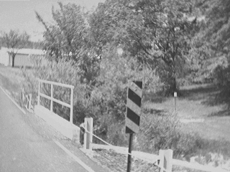
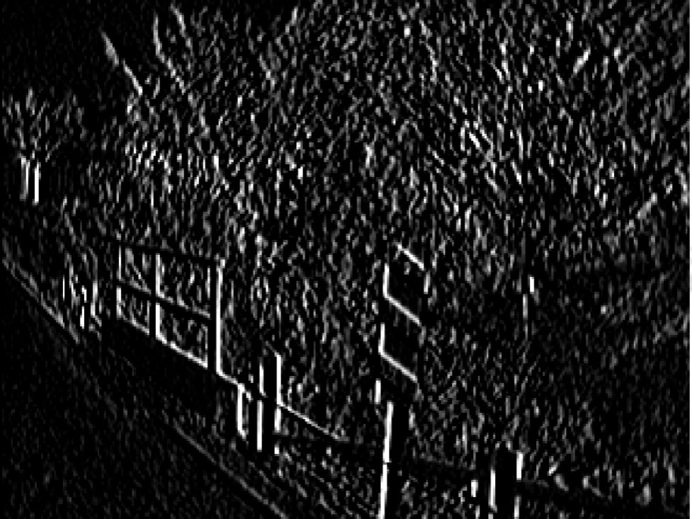
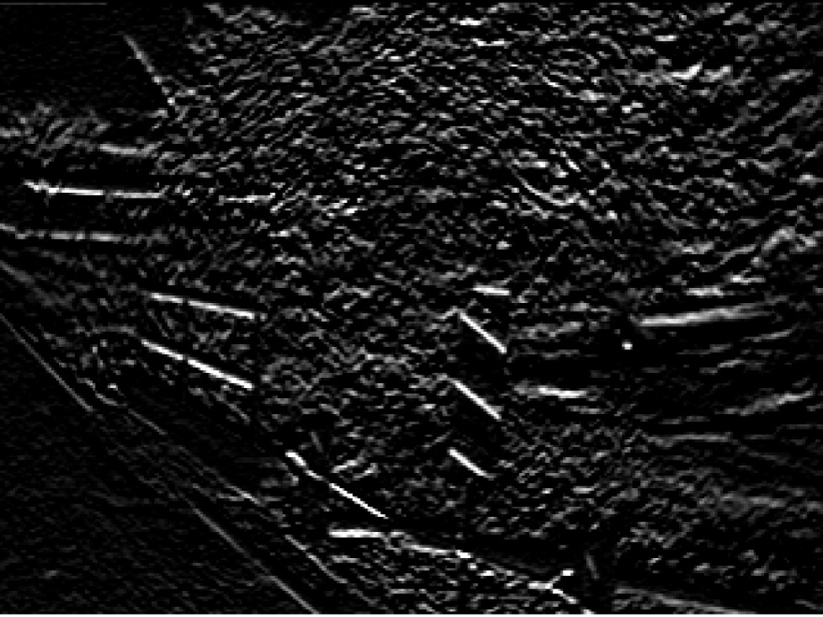
Sobel edge detection: example
Vertical edges
Horizontal edges

Slide 25
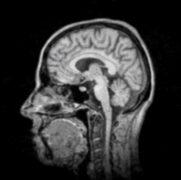
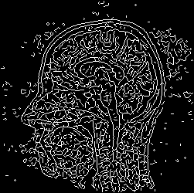
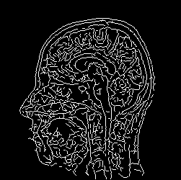
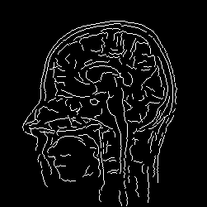
Change of threshold
small
threshold
large
Notes:
On determining an edge, we have to provide a threshold on the magnitude of the image gradient response

Slide 26
Problem with noisy image
Notes:
The above analysis was discussed for noise free case. In real world application, noise is everywhere. How to deal with noise while detecting image edge?
Here we show a single row from an image, from the image intensity, an edge is clearly defined. However when we evaluate the first order derivate, can you tell me where is the edge???

Slide 27
Solution: smooth the image first
Notes:
As a common strategy to noisy image, we can apply Gaussian filter to denoise the noisy image. By applying low-pass filter, we can obtain much smoothed image, then compute image gradient, detecting image edge is much easier.
In this implementation, we have to compute twice convolution, i.e., a Gaussian and Image gradient, can we ?

Slide 28
Derivative of Gaussian filter
Notes:
Yes, we can further speed up the implementation by using a nice property of derivative and Gaussian filter, namely computing the derivative of Gaussian filter equals to convolution of differentiation of Gaussian filter first and convolution later.

Slide 29
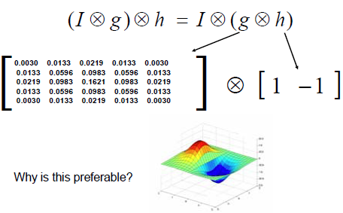
Derivative of Gauss filter in x direction
Notes:
What is the benefit?

Slide 30
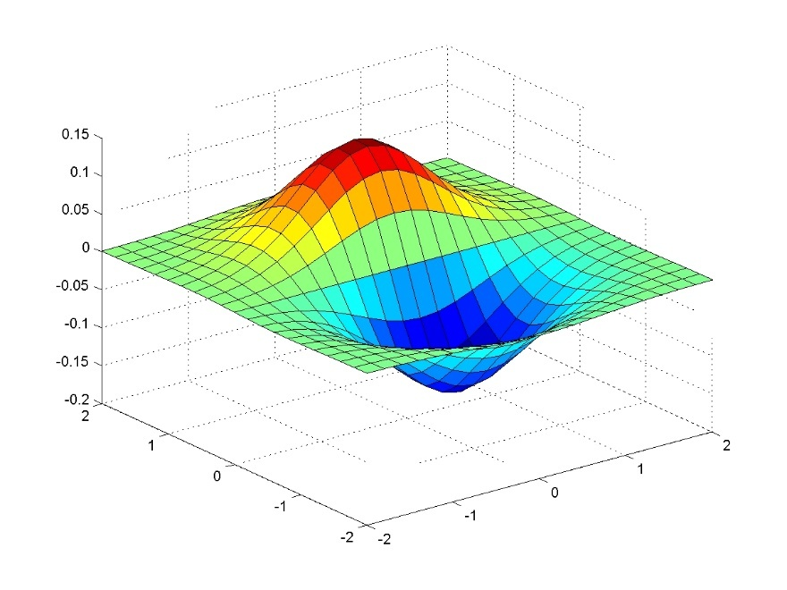
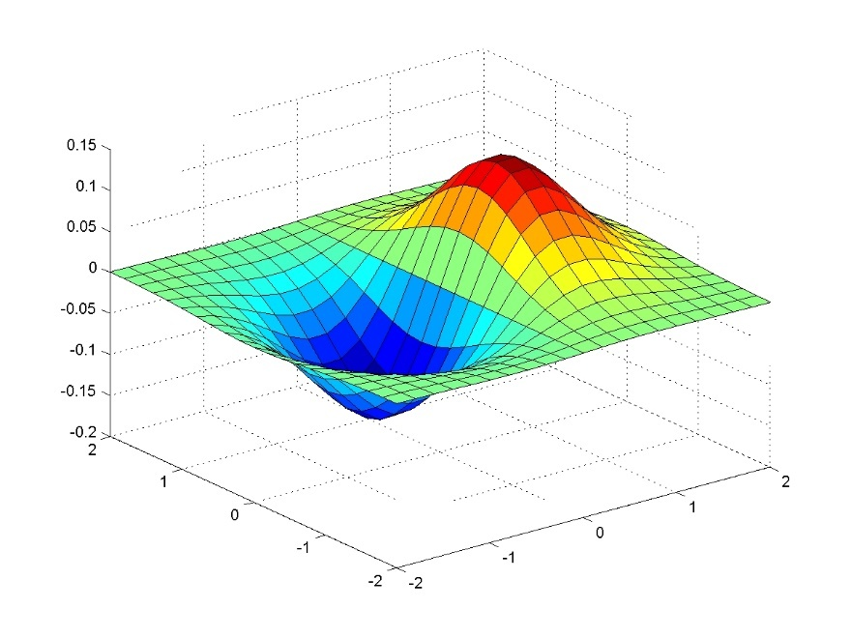
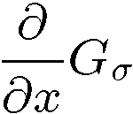
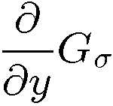
2D Deriv. Gauss filter pair

Slide 31
Edge as the zero-crossing of the second order derivative using Laplacian of Gaussian (LoG filter/Marr filter)
Notes:
Besides using the first order derivative, we can also use the second order derivative. Recall that for first order derivative, we detect the peak in response as edge. For second order derivative, we use the zero-crossing of the response to detect the edge.

Slide 32
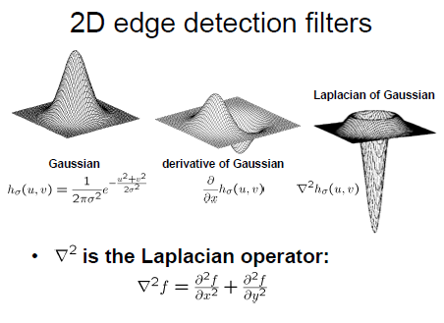
Notes:
Laplacian is defined as the sum of second order derivative.

Slide 33
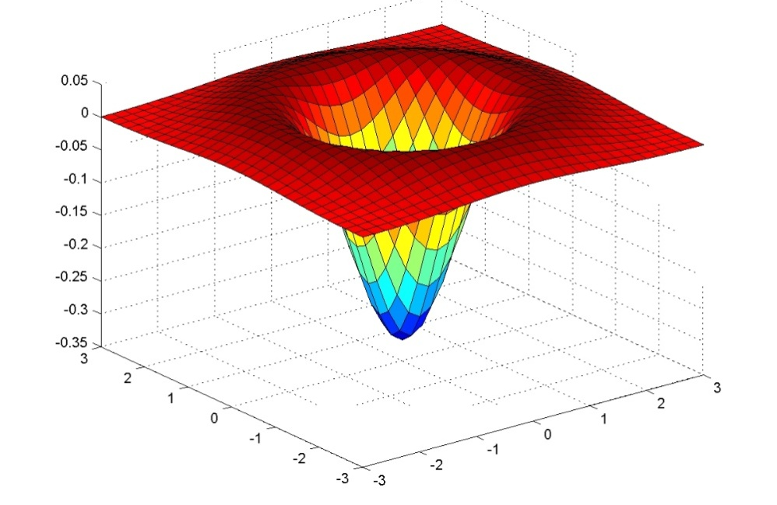
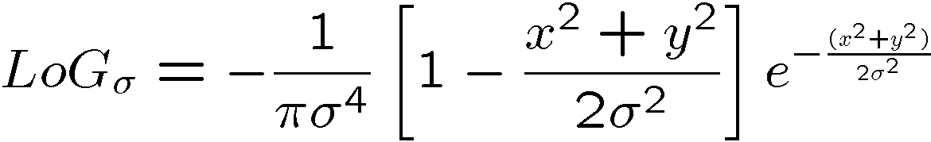
Laplacian of Gaussian (LoG): Marr edge detector
Matlab: fspecial(‘log’, sigma)

Slide 34
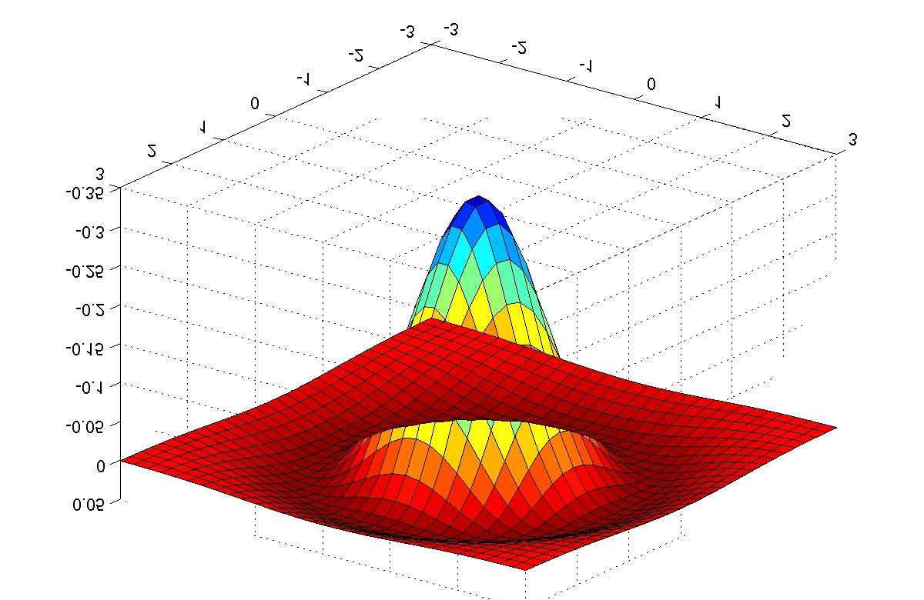
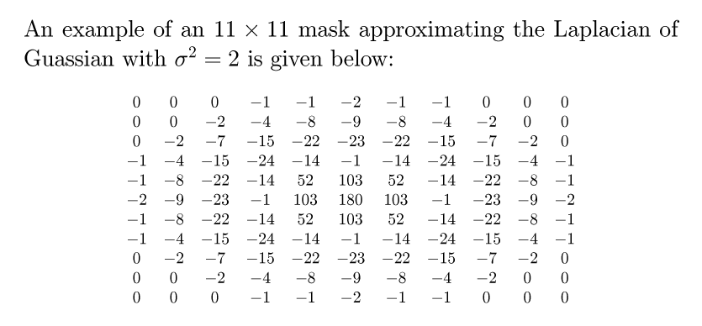
LoG kernel — Mexican hat

Slide 35
Detecting zero-crossings
The edge locations occur at points in the LoG-filtered image where the value passes through zero. i.e., where there is a sign change.
The number of zero crossings is influenced by the size of the Gaussian; the greater the smoothing, the smaller the number of zero crossings.
A simple algorithm is to declare a pixel p to be zero crossing if any one of its 8-neighbors is of opposite sign. To restrict the detected zero crossings to the more significant ones, we can impose a threshold T.
Notes:
Note that a sign change rather than zero directly

Slide 36
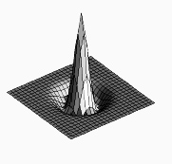

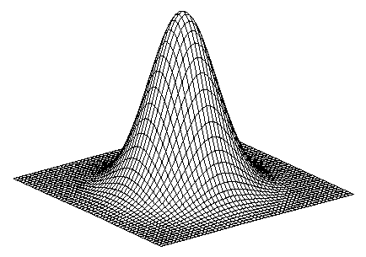
“Laplacian of Gaussian” (LoG) can be approximately computed as “Difference of Gaussians (DoG).
A narrow Gaussian
(or an impulse function)
A wide Gaussian
Laplacian of Gaussian
Notes:
Difference of Gaussians can be used to approximate Laplacian of Gaussian

Slide 37
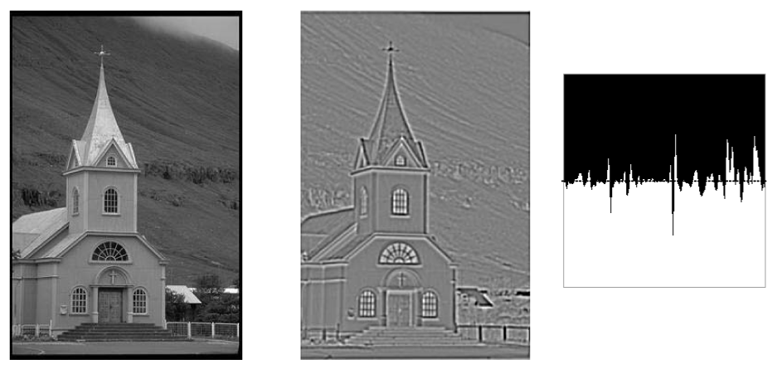
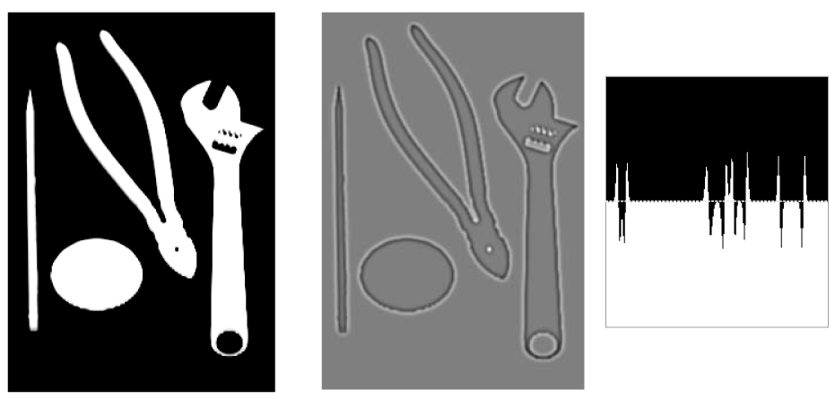
Example: 2-D LoG filtering

Slide 38
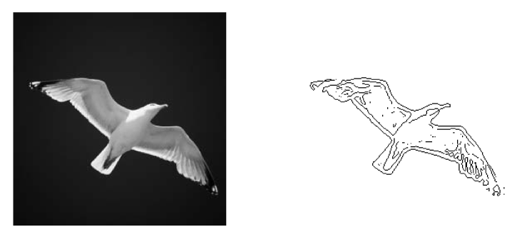
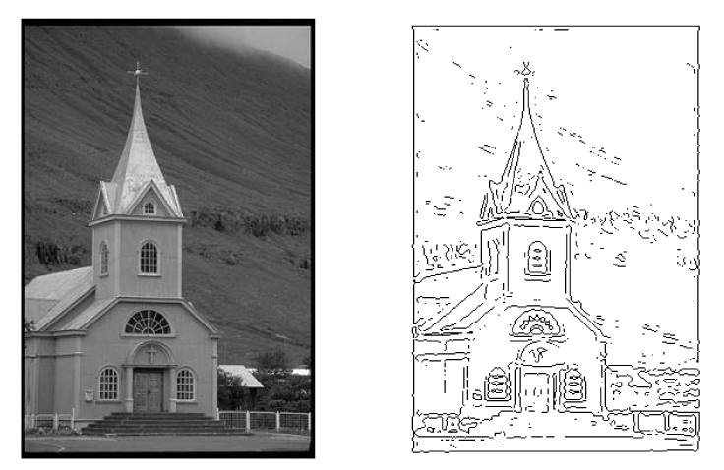
Example: LoG/Marr edge detector

Slide 39
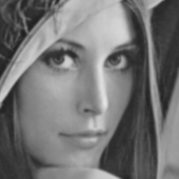


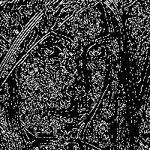
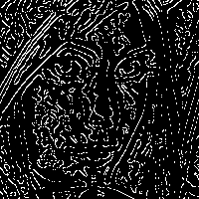
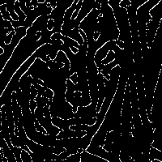
Change of Scale (sigma in Gaussian/LoG)
fine
coarse
Notes:
Continue tomorrow

Slide 40
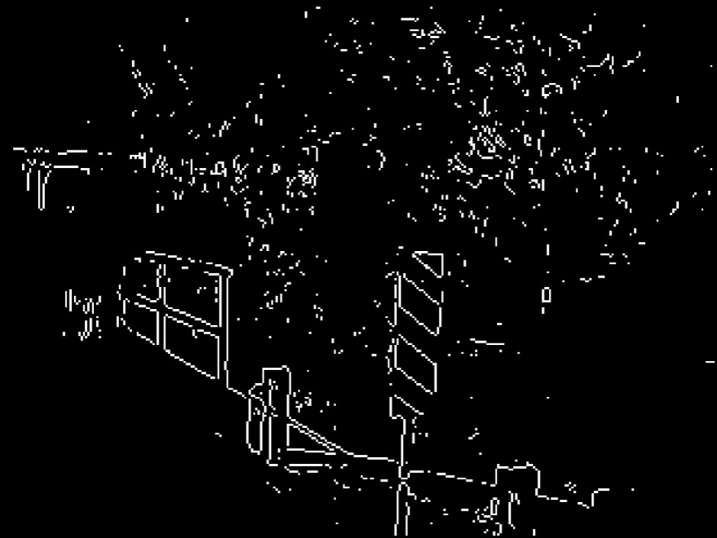
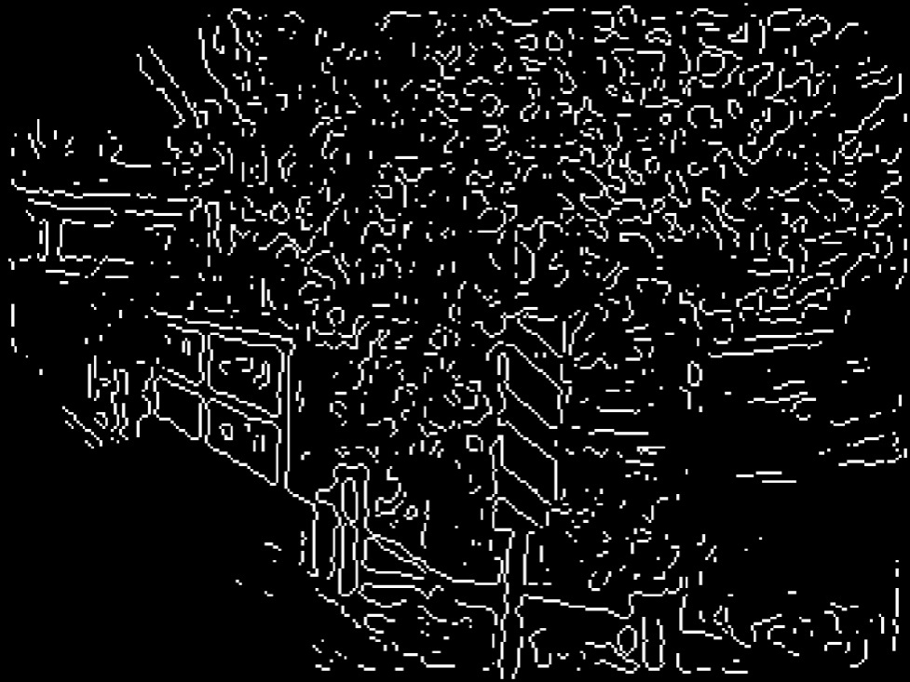
Sobel vs. LoG
Sobel
LoG

Slide 41
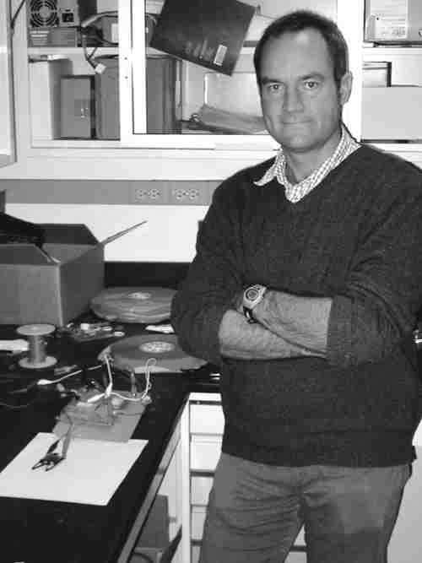
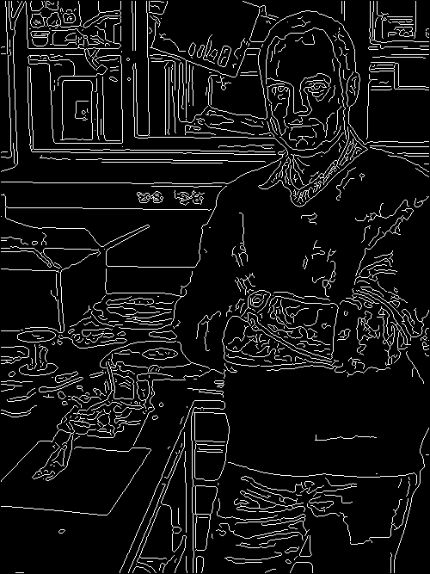
Canny Edge Detector
John Canny
Canny Edge Detector is one of the most successful edge detection method.
Ref: John F. Canny, “A computational approach to edge detection,” IEEE Trans. Pattern Analysis and Machine Intelligence, Vol. 8, No. 16, pp. 679-698, Nov. 1986.

Slide 42
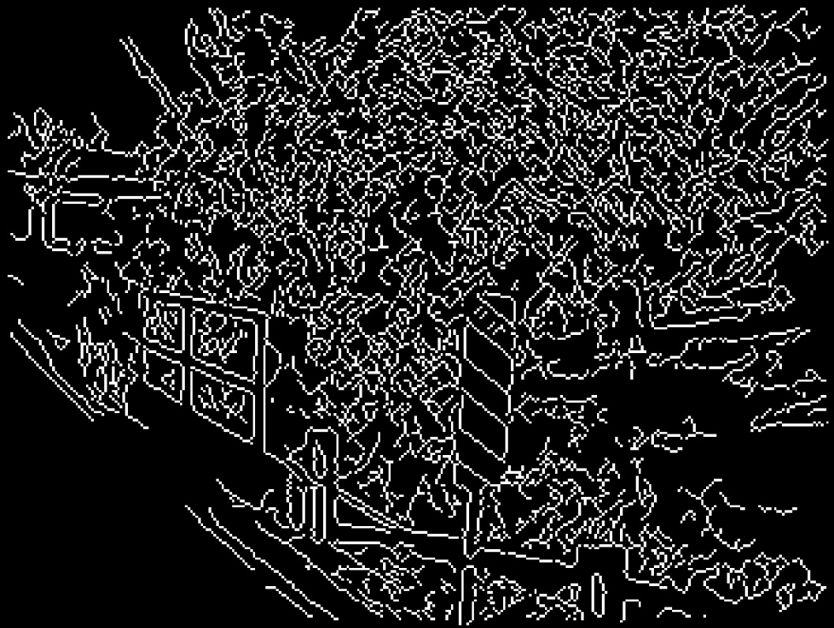
Canny Edge Detector
(Matlab automatically set thresholds)
Notes:
note painted lines on road preserved, whereas others didn’t

Slide 43

Example: Canny edge detector
original image (Lena)

Slide 44
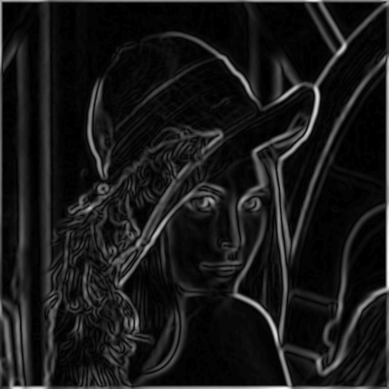
The Canny edge detector
norm of the gradient

Slide 45

The Canny edge detector
thresholding

Slide 46

The Canny edge detector
thinning
(non-maximum suppression, edge following)

Slide 47

Non-maximum suppression
Check if pixel is local maximum along gradient direction
requires checking interpolated pixels p and r

Slide 48
Canny Edge Detector is a statistically optimal edge detector
Make use of Derivative of Gaussian
Non-maximum suppression
Thin multi-pixel wide “ridges” down to single pixel
Optimal thresholding
Low, high edge-strength thresholds
Accept all edges over low threshold that are connected to edge over high threshold
Optimal decision making.
Matlab: edge(I,‘canny’,THRESH, sigma)

Slide 49




Canny edge detection
1. smooth
2. gradient
3. thresh, suppress, link
Canny is optimal w.r.t. some model.

Slide 50




Canny edge detection
1. smooth
2. gradient
3. thresh, suppress, link
And yet…

Slide 51


Canny difficulties
Modeling assumptions
Step edges, junctions, etc.
Parameters
Scales, threshold, etc.
Multiple sources of information
Only handles brightness
Real world conditions
Gaussian iid noise? Texture…

Slide 52
Modern methods
Modeling assumptions
Complex models, computationally prohibitive
Parameters
Many, may use learning to help tune
Multiple sources of information
Typically brightness, color, and texture cues
Real world conditions
Aimed at real images

Slide 53
Machine learning based edge detector
To learn how human label edges of natural images.
Notes:
After discussing the classical edge detecting methods, we move forward to modern edge detectors. All the previous edge detectors are specifically designed by using different properties of edges. As we have discussed, edge detection is not so well defined, thus instead of designing dedicated edge detectors, we resort to machine learning based method, i.e., learn how human detects edge.

Slide 54








Sample human-labeled training images and their corresponding edge maps

Slide 55

Notes:
How to learn an edge? First, we have to define feature extractors to represent edge and non-edge. Thus transfer to a standard machine learning problem.
Brightness, color, texture have been used

Slide 56








Learned edge detector: Pb (probability-of-boundary) edge I
Image
Canny
Pb
Human
Notes:
Pd denotes ” probability-of-boundary”

Slide 57








Pb result II
Image
Canny
Pb
Human

Slide 58








Pb result III
Image
Canny
Pb
Human

Slide 59

State-of-the-art edge detection
Deep learning based edge detection

Slide 60

State-of-the-art edge detection (HED Holistic Edge Detection)
Notes:
2015 Marr Prize Honorable Mention More Deep Learning Work

